Slide 1




MOVIE
BOOKING
SYSTEM
Team Members:
Sourav Banerjee
Srujitha Raghava
Shubham Soni
Balakeerthi. S
Venkatraman. P

Slide 2
ABOUT OF THIS PROJECT
Primary Objective: Manage details related to seats, bookings, customers, payments, and shows.
Scope: Controls all information about seats, movies, and show schedules.
Administrative Access: System is designed exclusively for administrator use.
Goal: Develop software to reduce manual effort in managing:
Seats
Bookings
Movies
Customer data
Tracking Capabilities:
Customer details
Payment information
Show schedules

Slide 3

Used Technologies
Frontend: CSS, JavaScript, JSP
Backend: Java Spring Boot 3, Spring Data JPA, Spring Security
Database: MySQL 8.0
Build Tool: Maven
Code Editor and tools: Eclipse IDE
Server: Apache Tomcat 9

Slide 4
USER AUTHENTICATION AND AUTHORIZATION
01
MOVIE MANAGEMENT
02
MODULES THAT ARE IMPLEMENTED
MULTIPLEX MANAGEMENT
03
SHOWTIME MANAGEMENT
04
BOOKING MANAGEMENT
05
Implement user registration, login, and role based access control.
Add, update, delete, report and Find by language
Add, update, delete, and theatre report
Add and showtime report
Create, update, delete, and view bookings.

Slide 5
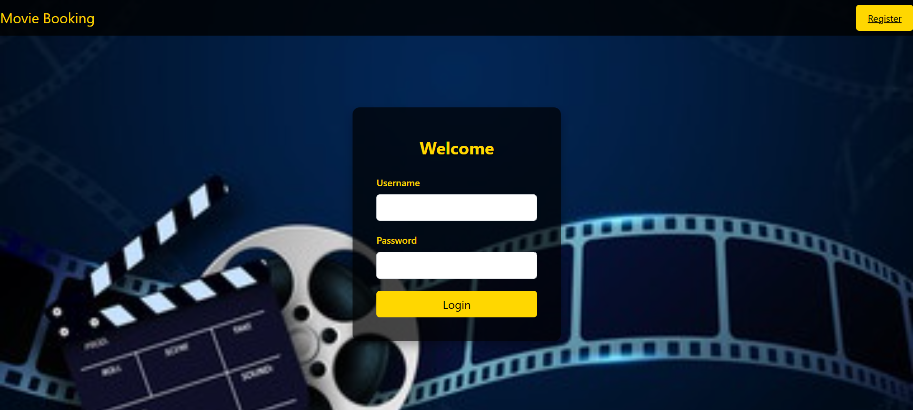
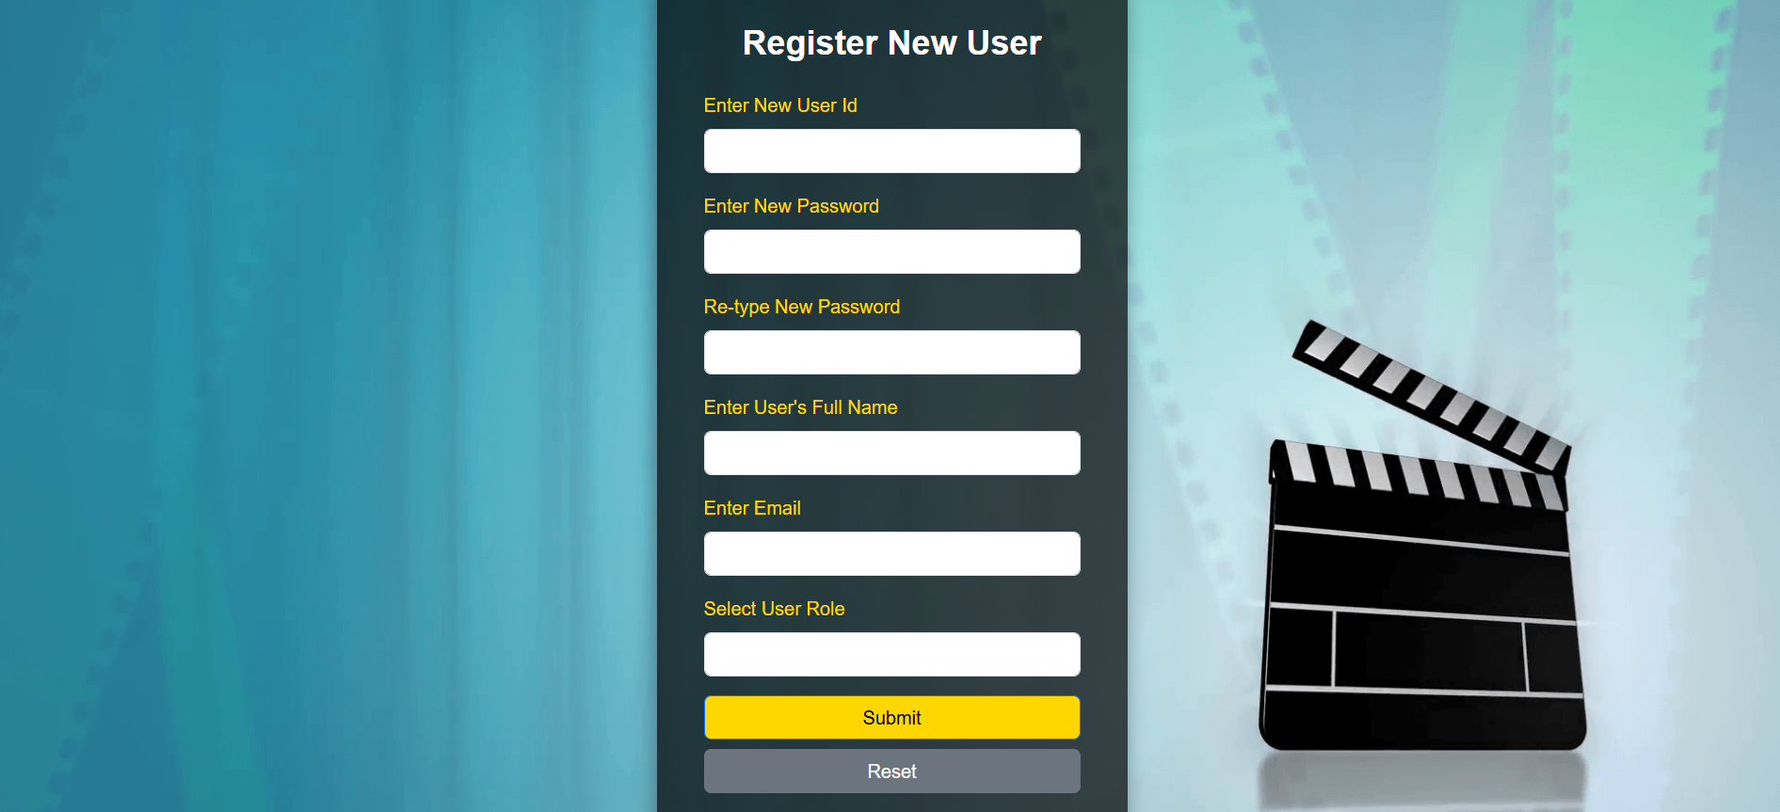
USER AUTHENTICATION AND AUTHORIZATION
LOGIN PAGE
For both administrators and users, the login page ensures secure access to the system.
Administrators can log in using their credentials to manage movies, showtimes, and bookings.
Users can log in to access their booking history and personal details.
REGISTER PAGE
The registration page lets new users create an account for bookings and personalized features by entering their personal information.
Administrators can also register new admins, ensuring secure and controlled access to administrative functions.
This setup offers streamlined and secure access tailored to each user's needs

Slide 6

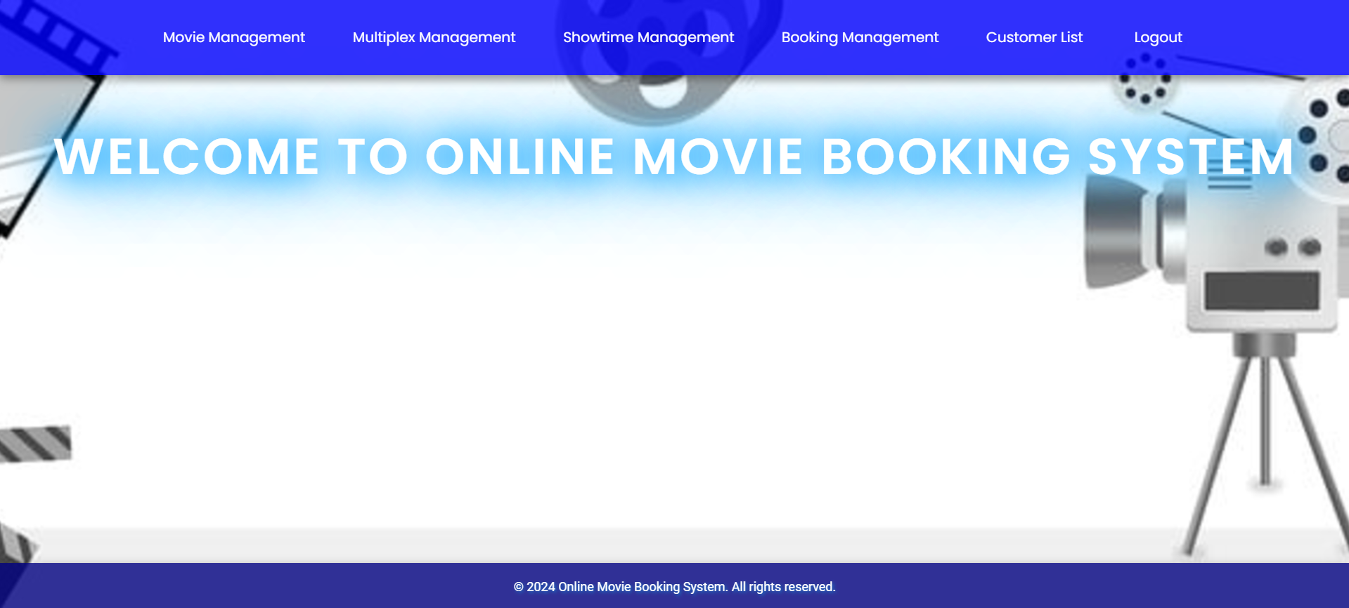
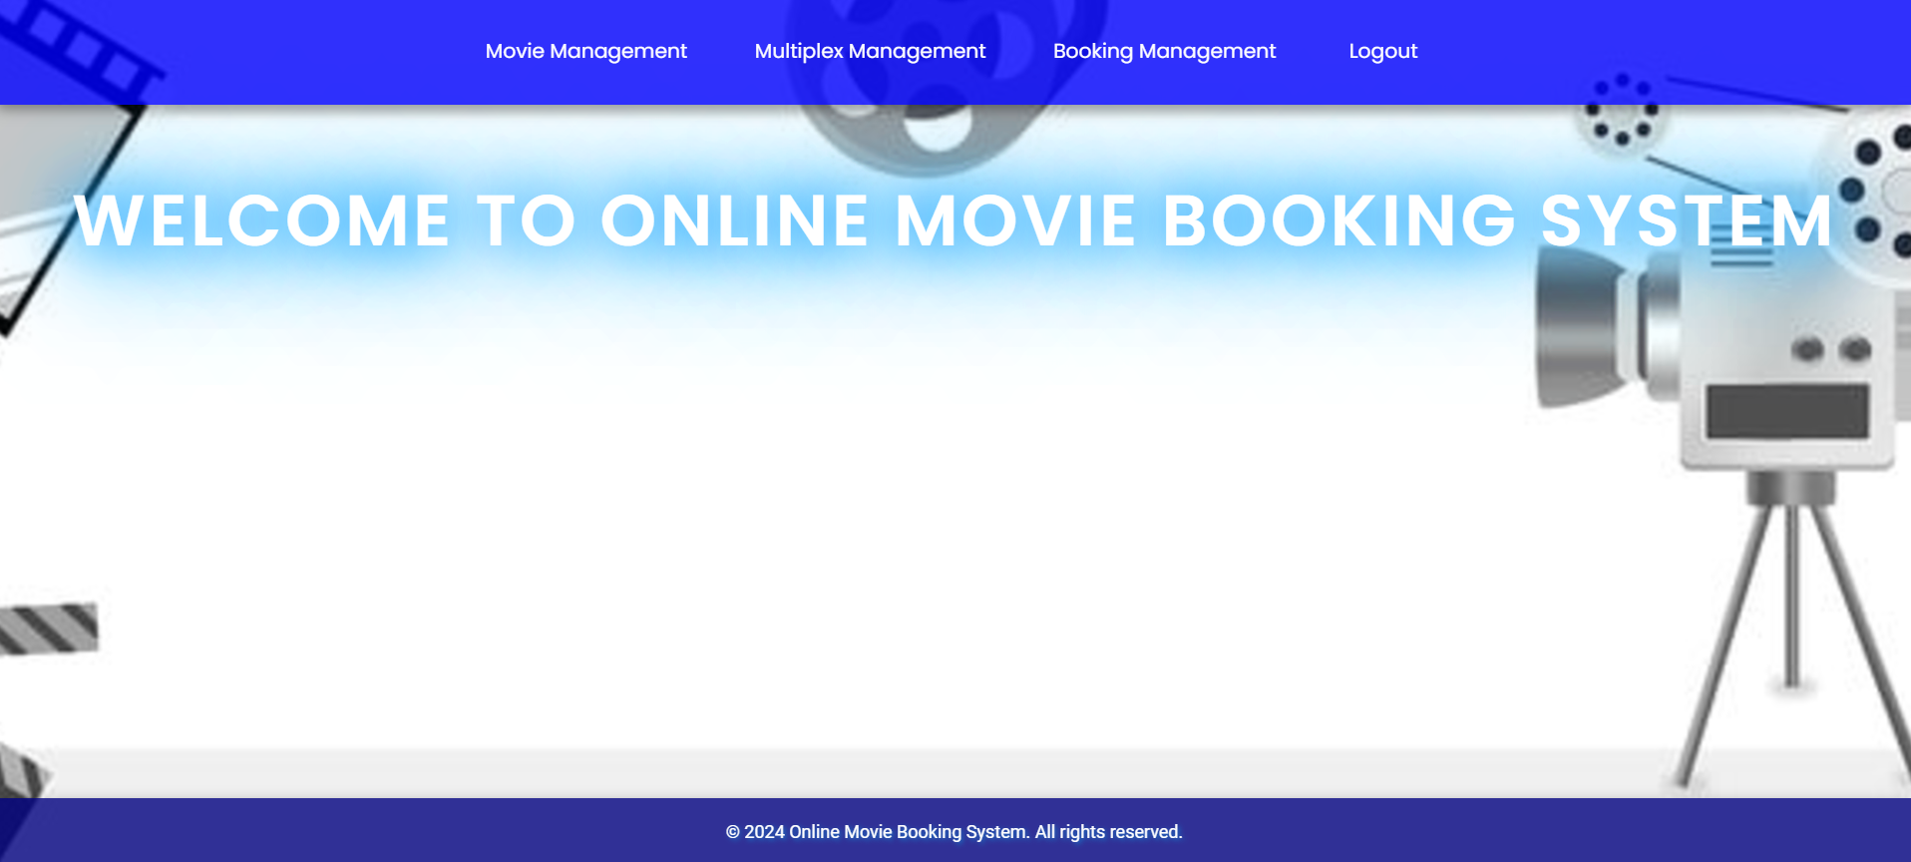
INTERFACE ADMIN
USER INTERFACE
The Admin Dashboard offers a comprehensive overview with sections for managing movies, showtimes, and bookings.
Admins can quickly access movie details, modify showtimes, view recent bookings, generate reports, and receive notifications
OVERVIEW AND MANAGEMENT
The User Home page provides a streamlined experience with sections for movie listings, quick booking, personalized recommendations, booking history, and profile management.
Users can easily find and book tickets while managing their personal details.

Slide 7
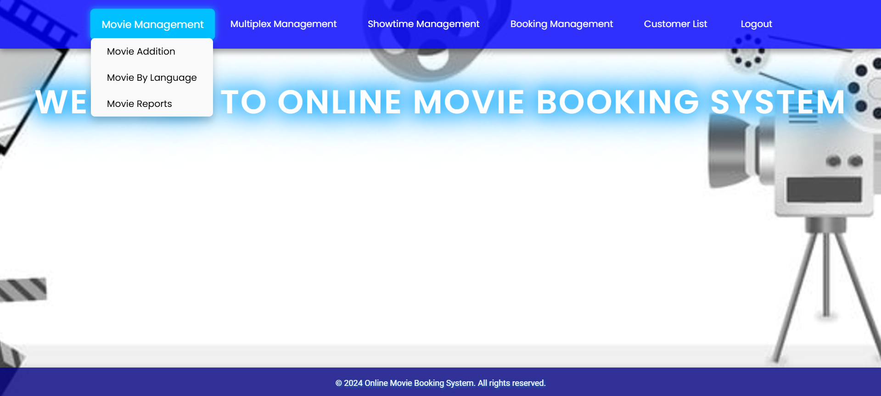
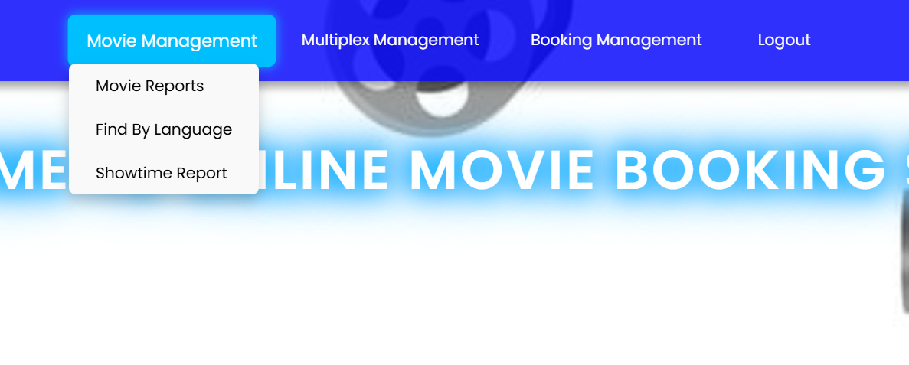
ADMIN INTERFACE
USER INTERFACE
Administrators can manage movies by adding new ones, modifying details, updating information, and deleting films.
They can access detailed movie reports, which allow for real-time updates.
The admin interface also includes a booking button, enabling admins to book tickets on behalf of customers
MOVIE MANAGEMENT
Users can view detailed movie reports and book tickets.
The user interface is designed for a straightforward and efficient booking process, with the main interaction being the booking button to reserve seats for shows.

Slide 8
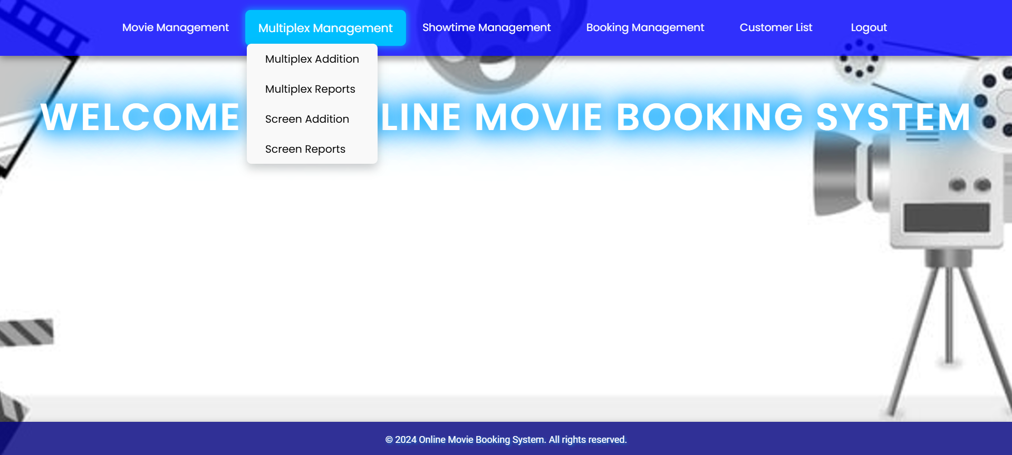
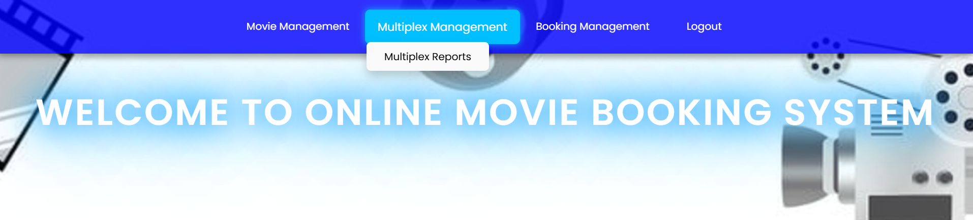
ADMIN INTERFACE
USER INTERFACE
Administrators can manage multiplex by adding new ones, updating existing theatre details, and deleting theatres as needed.
They also have access to detailed theatre reports, which provide insights and allow for real-time updates.
MULTIPLEX MANAGEMENT
Users can view multiplex reports to get information about the theatres, such as location, facilities, and show availability.
This interface focuses on providing relevant details to help users make informed decisions.

Slide 9
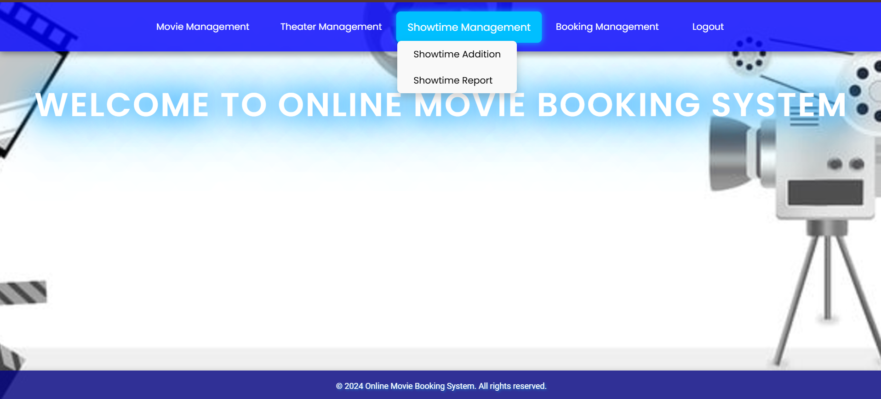
ADMIN INTERFACE
SHOWTIME
MANAGEMENT(ADMIN ONLY)
Administrators have the exclusive ability to manage showtimes. They can add new shows based on the theatre's schedule and requirements.
This includes selecting the movie, assigning it to a screen, and setting the showtimes. Additionally, admins can generate and view detailed showtime reports, providing insights into show performance and attendance.
This feature ensures that the scheduling of shows is efficient and meets the demand.

Slide 10
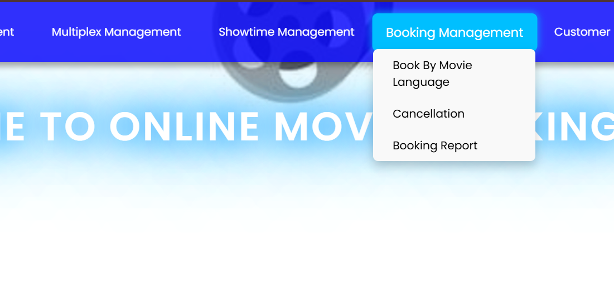
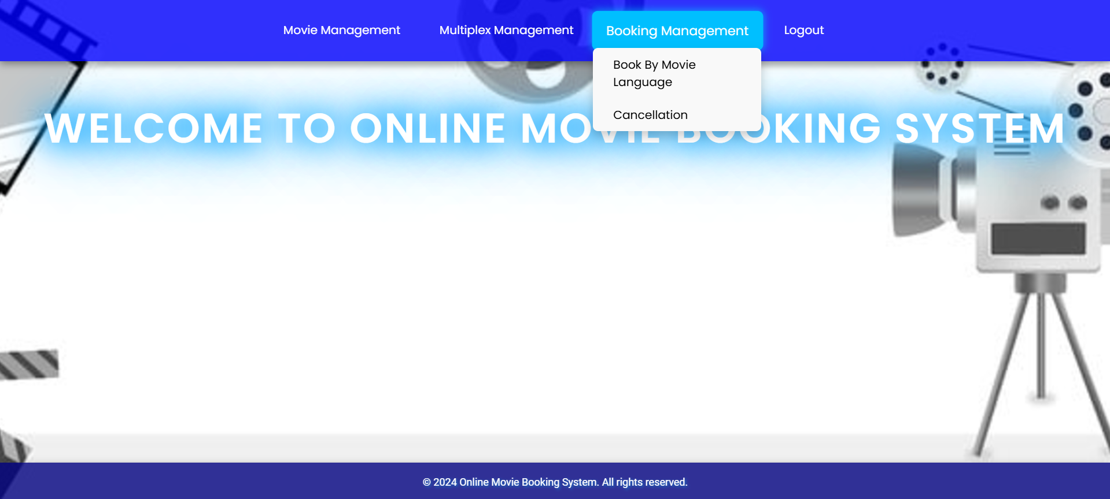
ADMIN INTERFACE
USER INTERFACE
Administrators can manage bookings by using the "Book by Language" feature, which allows customers to filter and book movies based on language preference.
They also have access to booking reports, providing insights into booking trends, occupancy rates, and financial summaries.
BOOKING MANAGEMENT
Users can utilize the "Book My Movie" feature to easily search and book movies based on their preferred language.
This feature streamlines the booking process, making it user-friendly

Slide 11
Online Payment Integration:
AI-Powered Recommendations:
Mobile Application:
Microservice:
Implementing additional payment gateways will provide more convenient and secure transactions for users. Enhancing their overall experience and encouraging continued use of the system
Utilizing machine learning algorithms will help provide more accurate and personalized movie suggestions. By analyzing user behavior, the system can continually improve the user experience.
FUTURE ENHANCEMENT
Developing a mobile app will make booking and managing tickets even more accessible. Users will benefit from push notifications for show reminders and special offersand engaged with the platform.
Java microservices offer scalability, independent deployment, resilience, and technology flexibility. Unlike monoliths, they enable faster updates, isolate failures, and allow teams to develop and scale individual components efficiently.

Slide 12



THANKS
Thank you for your time and attention!
SOURAV BANERJEE
UNDER THE GUIDANCE OF:
SRUJITHA RAGHAVA
SURAMYA BISWAS
SHUBHAM SONI
BALAKEERTHI. S
VENKATARAMAN. P

